Slide 1
Provenance: The New Chapter In The Museum Narrative
Paul Caserta & Victoria Reed
Notes:
Good afternoon everyone and thank you for joining us for our presentation today. (Introductions)

Slide 3
Where We Began
Objects and documents are a source of identity from our past that each hold a story; a narrative of social and cultural history.

Slide 4
Provenance
Information regarding the origins, custody, and ownership of an item or collection.
A fundamental principle of archives, referring to the individual, family, or organization that created or received the items in a collection.
Provenance Access
A technique of locating relevant materials based on characteristics of the origins of the materials (the provenance).

Slide 5
Archivists and Their Collections
Historians and Archivists
Growing requirements for more standards, preservation and participation in the digital world = less time to commit to research.

Slide 6
Where Do We Go Next with the Narratives of our Collections?
Accessioning Oral Histories with Collections
Hello World! (using the World Wide Web)
Using standard metadata and terminology in order to “Google it”.

Slide 7
Leading our End-Users to Collections
Physical and Digital Exhibitions
Social Media
Grants (Oral history, archives, museums, historical societies, secondary education)

Slide 8
Examples
On the Water-Commercial Fishers-Whaling
facebook.com/Massachusetts Historical Society

Slide 9
Examples
www.artstor.org/index.shtml

Slide 10
The Benefits
Advance scholarly research
New educational opportunities

Slide 11
Difficulties
1. Resources
2. People changing from traditions
3. Donor relations

Slide 12
Curator FOR Provenance
Victoria Reed

Slide 13
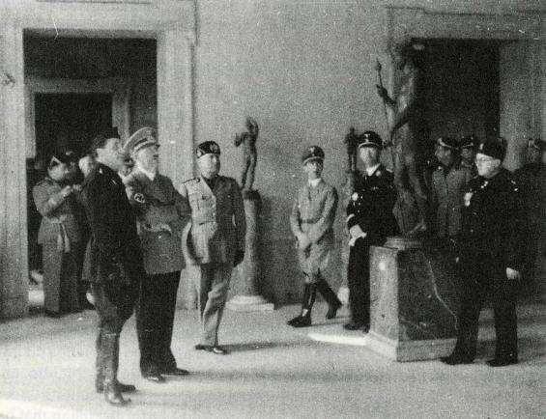
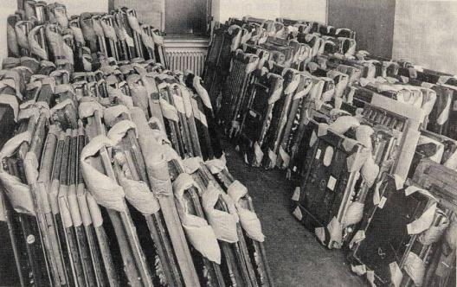
Hitler and Mussolini at the
Borghese Gallery, Rome, 1938.
Nazi looted paintings in Munich,
ca. 1945/1956

Slide 14
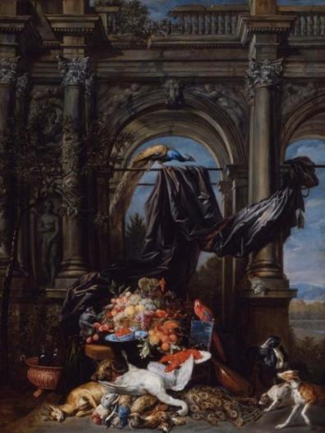
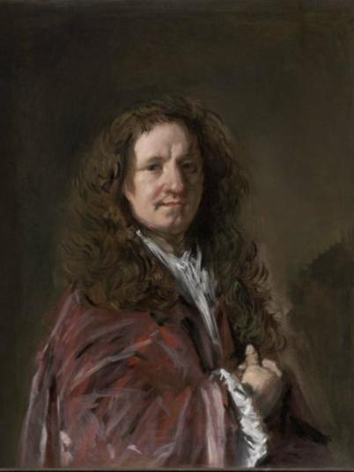
Jan Fyt and Erasmus Quellinus
Still Life in an Architectural Setting
Looted from the Rothschild collection, Vienna
Returned by Allied forces to the family
Sold to the MFA, 1950
Frans Hals, Portrait of a Man
“Retained” by Austrian authorities when
Leon and Antonie Lilienfeld fled Vienna in 1938;
Returned after World War II;
Donated to the MFA, 1966

Slide 15
1998/1999:
American Association of Museums – Association of Art Museum Directors
identify all objects in their collections that were created before 1946 and acquired by the museum after 1932, that underwent a change of ownership between 1932 and 1946, and that were or might reasonably be thought to have been in continental Europe between those dates;
(2) make currently available object and provenance (history of ownership) information on those objects accessible; and
(3) give priority to continuing provenance research as resources allow.

Slide 16
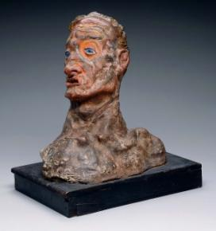
Exhibition catalogue “Kokoschka,” Buchholz Gallery, New York, 1941

Slide 17
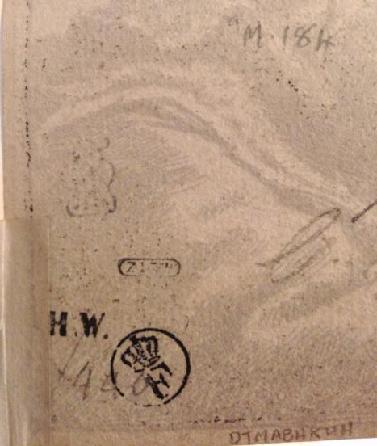
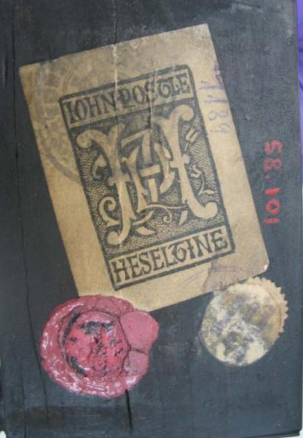
Reverse of a Rembrandt print
Underside of the base of a Renaissance
sculpture

Slide 18
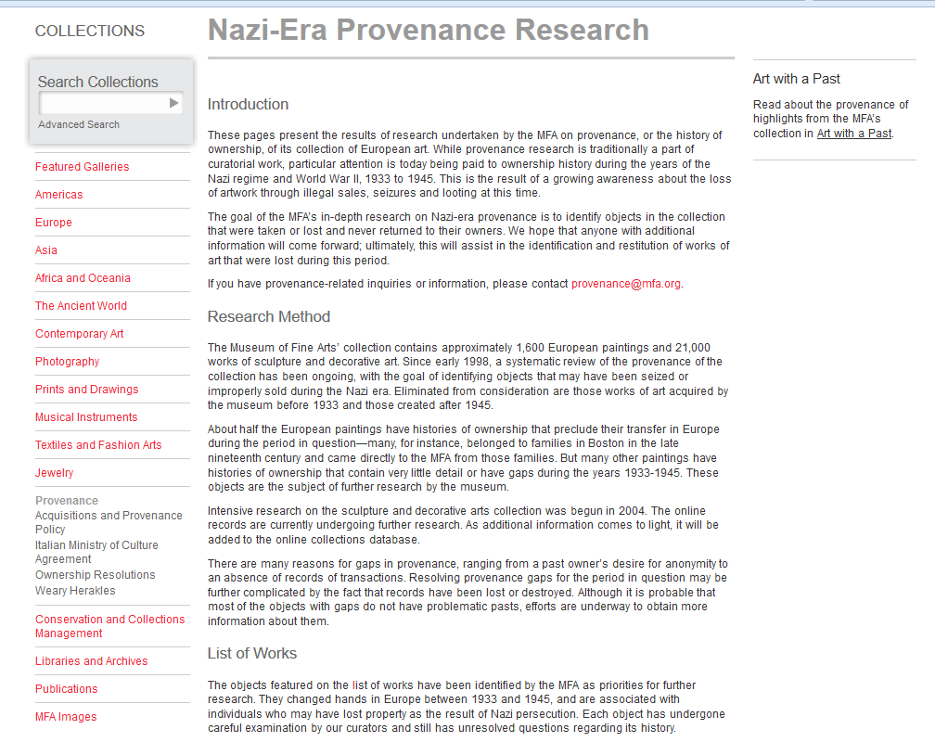
MFA’s provenance
web page

Slide 19
World War II Theft and Looting

Slide 20
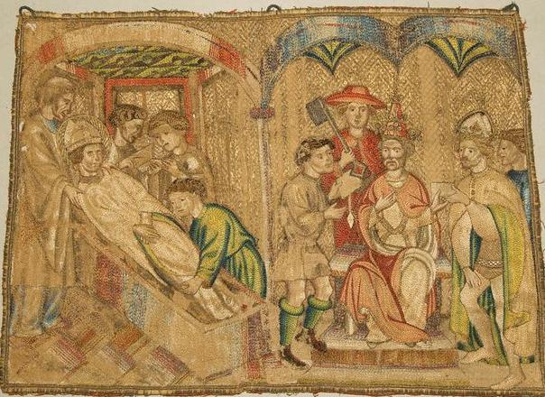
Acquired in 1946 as: Probably Italian, 14th century, Embroidered panel

Slide 21
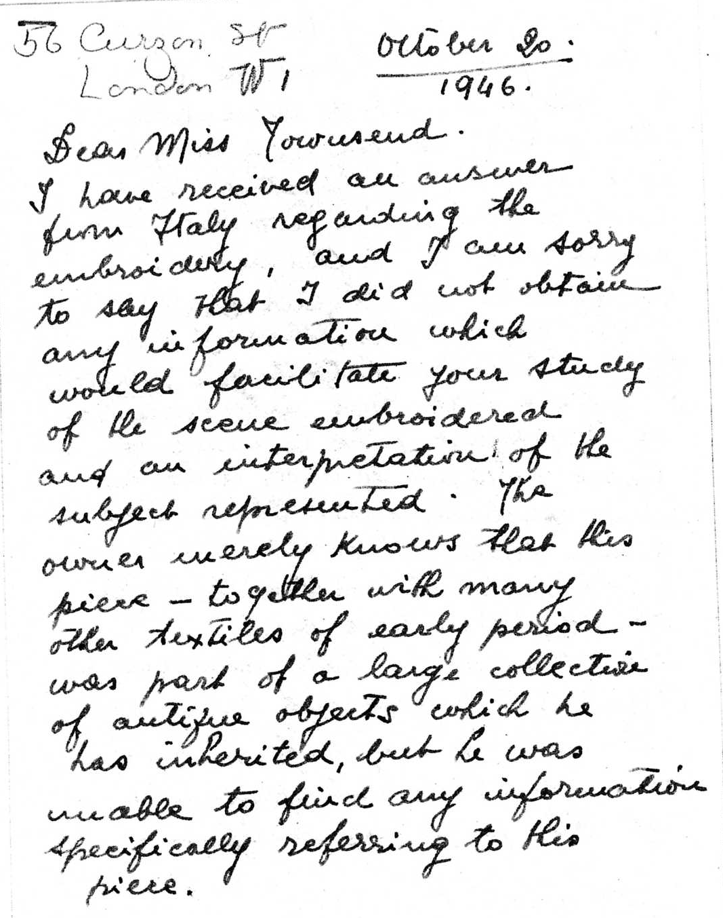
“The owner merely knows that this piece – together with many other textiles of early period – was part of a large collection of antique objects, which he has inherited, but he was unable to find any information specifically referring to this piece.”
Brooklyn dealer Arturo Grassi to MFA curator Gertrude Townsend, October 20, 1946

Slide 22
BIBLIOGRAPHY:
[Luigi Campi, “Arredi sacra di recamo nella cattedrale di Trento,” pp. 381-390 and L. Cesarini-Sforza, “Gli atti di San Vigilio,” pp. 3-29 in Scritti di storia e d’arte. Per il XV centernario di s. Vigilio vescovo e martire (Trent, 1905). Cannot locate within the U.S.]
[Catalogo Illustrato, 1905, p. 74. Cannot locate within the U.S.]
Vincenzo Casagrande, Catalogo del Museo Diocesano di Trento (Trent, 1908), pp. 13-17, MFA panel is cat. no. 14 on p. 16, ill. no. 12. Catalogued as the Burial and Canonization of St. Vigilius, 33.9 x 49 cm. Described, and said to come from the cathedral of Trent.
[Giuseppe Gerola, “A proposito degli affreschi della Torre dell’Aquila,” Giornale di Trento, October 24-25, 1923, n.p. Cannot locate within the U.S.]
Heinrich Kohlhaussen, Gotisches Kunstgewerbe, in Geschichte des Kunstgewerbes aller Zeiten und aller Völker, ed. Helmuth Theodor Bossert, vol. 5 (Berlin, 1932), pp. 450-451. Series of panels mentioned, as early 15th century.
Antonio Morassi, Storia della pintura della Venezia tridentina (Rome, 1935), pp. 353-357. Described as one of five panels at the treasury of the Trent cathedral showing the story of St. Vigilius. The panel representing the deposition (entombment) of Saint Vigilius was originally on the hood of the vestment while the others adorned the tunic. The vestment probably belonged to the bishop of Liechtenstein and the panels probably date to the end of the 14th century of beginning of the 15th. Series discussed regarding style and date.
Bulletin of the Museum of Fine Arts, 45, no. 259 (February, 1947), p. 19. Listed as a recent acquisition.

Slide 23
Domenica Diglio, in Ori e argenti dei santi. Il tesoro del duomo di Trento, ed. Enrico Castelnuovo (1991), pp. 92-93, cat. no. 13. The four Trent Museum panels are catalogued and illustrated. The author notes that “originally, there were certainly more [scenes] (still at the beginning of the 20th century there were five) illustrating episodes from the ministry and martyrdom of St. Vigilius.”
E[velin] W[etter], in Il Museo diocesano Tridentino, ed. Domenica Primerano (Trent: Museo Diocesano, 1996), pp. 113-116: as Bohemian (Prague), ca. 1391. Four panels from the St. Vigilius series catalogued and discussed; “at the beginning of this century, the Museo Diocescano Tridentino owned a fifth panel, which today is lost.” MFA panel illustrated.
Vesti liturgiche e frammenti tessili nella raccolta del Museo Diocesano tridentino, ed. Donata Devoti et al. (Trent: Museo Diocescano, 1999), cat. no. 1, pp. 40-48: as Bohemian, 1390-1400. Series is catalogued and discussed. MFA panel mentioned on p. 46: “of this rich set of vestments, largely lost, there was, still at the beginning of the twentieth century, a fifth panel…”
Domenica Diglio, L’immagine di San Vigilio, tra storia e leggenda, ed. Domenica Primerano (Trent: Museo Diocesano, 2000), pp. 180-186, cat. no. 2, MFA panel ill. on p. 184. All five panels in the series are catalogued and discussed. “The fourth panel, included in the 1908 catalogue of the Diocesan Museum in Trent, but today lost, represents the burial of St. Vigilius and his canonization.”
Evelin Wetter, Böhmische Bildstickerei um 1400: Die Stiftung in Trient, Brandenburg und Danzig (Berlin: Gebr. Mann, 2001). On the iconography of the MFA panel see esp. pp. 50-52, fig. 15, described as lost. The set is catalogued on pp. 124-125. Dated 1390-91.
Ibid., in Il Gotico nelle Alpi, 1350-1450, ed. Enrico Castelnuovo and Francesca de Gramatica (Trent, 2002), pp. 514-517, cat. no. 45.,“a fifth panel was lost...” Discussion of panel’s iconography, which Wetter notes is based on a photograph because it the object itself is lost, on pp. 516-517.

Slide 24
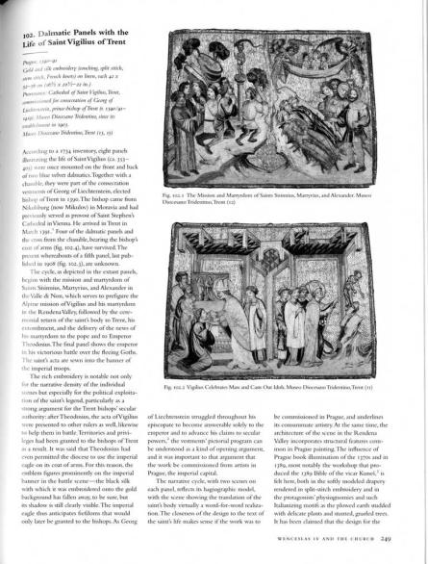
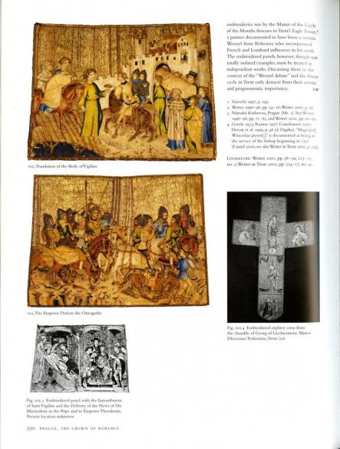
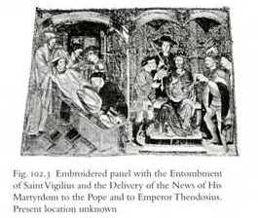
Catalogue of exhibition “Prague: The Crown of
Bohemia,” Metropolitan Museum of Art, 2005.

Slide 26
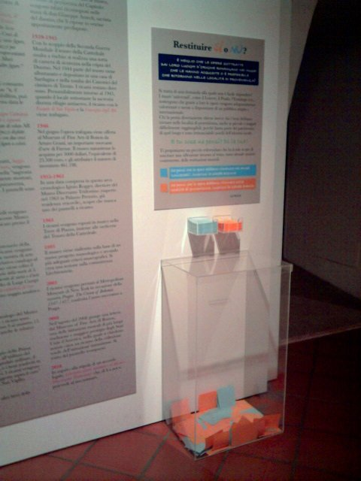

Slide 27
Forced sale due to Nazi persecution

Slide 29
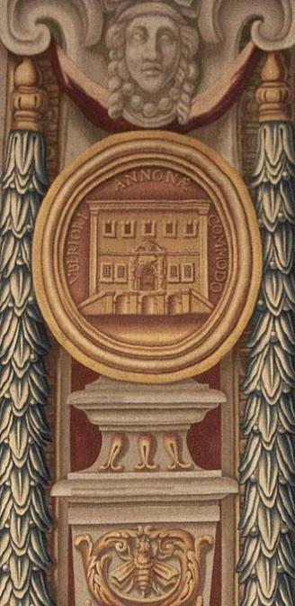
Four pillar tapestries
From the series THE LIFE OF POPE URBAN VIII
Italian (Rome), 1663–1679
Manufactured by Barberini Manufactory,
Rome, Italy
Dimensions Overall: 567.1 x 134 x 134 cm (223 1/4 x 52 3/4 x 52 3/4 in.)
Provenance:
Collection Margraf and Co., Berlin.
Collection Eugene L. Garbáty, New York. Gift of Eugene L. Garbáty, in memory of his parents, Josef and Rosa Garbáty.

Slide 30
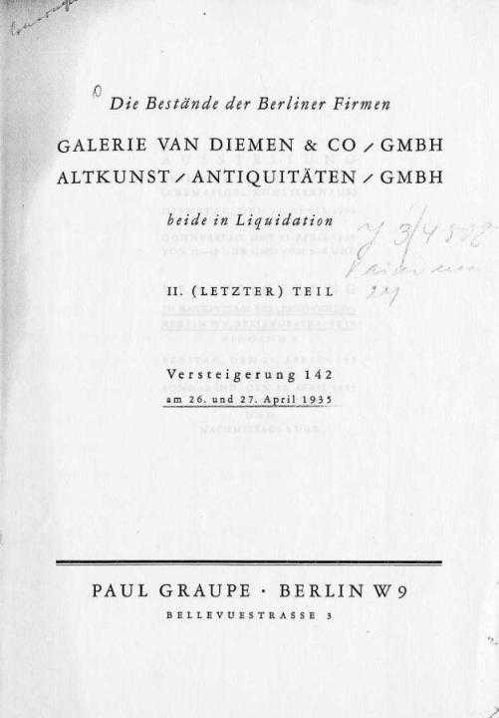
Berlin, 1935
Van Diemen and Altkunst Galleries (Margraf Co.)
“In liquidation”

Slide 31
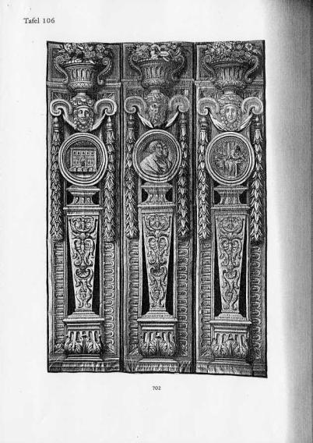
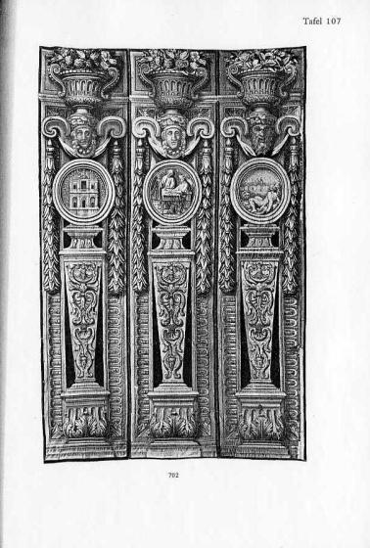
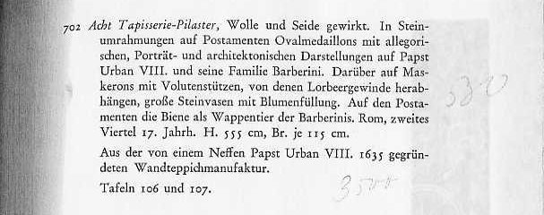
1935:
Margraf sale, to an
unknown buyer

Slide 32
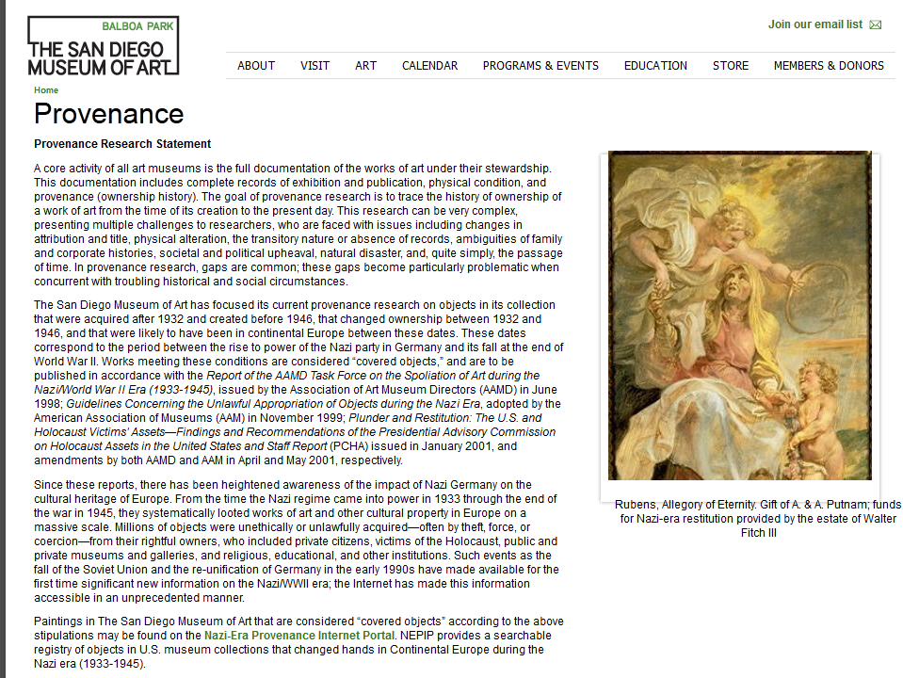

Slide 33
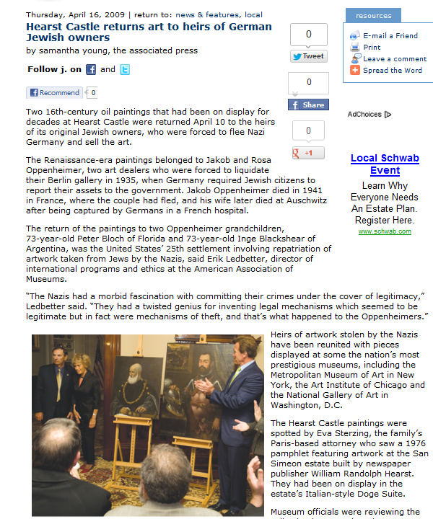

Slide 34
Provenance:
Between 1663 and 1679, created for the Barberini family, Palazzo Barberini, Rome; last quarter of the 19th century, series removed from the Palazzo Barberini and sold. By 1928, Altkunst Antiquitäten, Berlin; April 26-27, 1935, Altkunst liquidation sale, Paul Graupe, Berlin, lot 702, sold for RM 530. About 1935, acquired from an unknown dealer by Eugene L. Garbáty (b. 1880 - d. 1966), Schloss Alt-Döbern, Niederlausitz (Germany), Paris, and New York; 1952, gift of Eugene Garbáty to the MFA. (Accession Date: February 14, 1952)

Slide 35
“Immediately after April 1, 1933, the persecution began. The companies of the Margraf Consortium were especially detested by the Nazi authorities, since they were owned by Jews. The companies were known on the international art market and were among the largest art dealerships. In addition, even the authoritative employees – if they were not Jewish – were not members of the party. The art businesses were thus completely unprotected and were perpetually pressured by various centers (official and Nazi centers) to sell their valuable property without regard to the price and without regard to the impact of such sales on the market. “
Sworn statement, 1956, by Eduard Plietzsch
Compensation claim files, Margraf and Co.

Slide 36
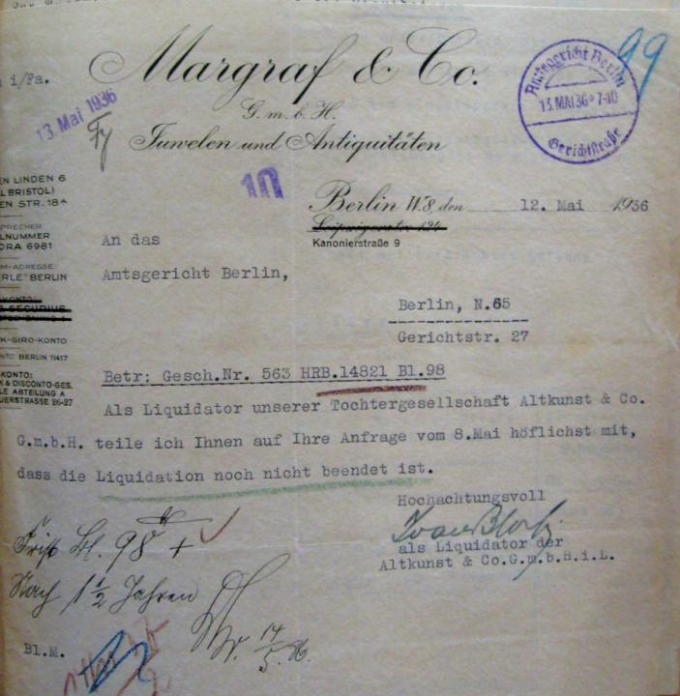
1936 document regarding
the liquidation of the gallery
(Business registry file, Berlin)

Slide 37
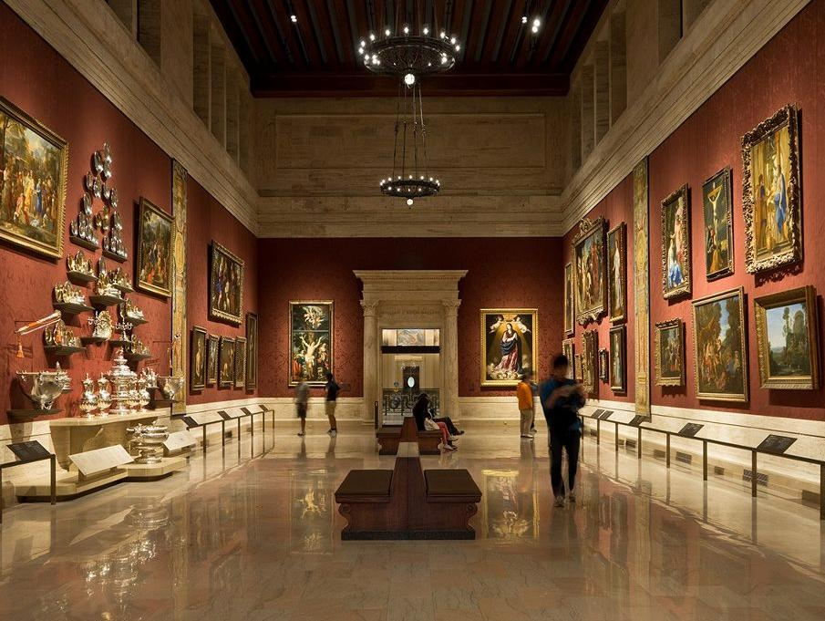
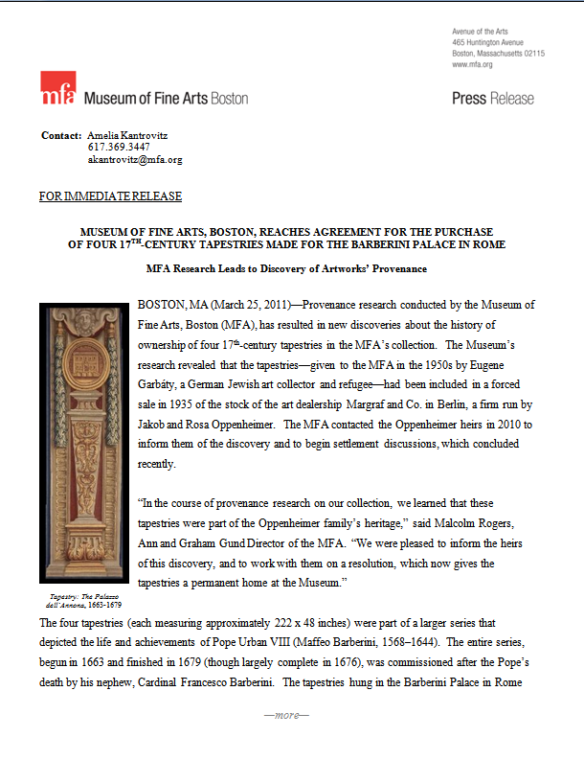

Slide 38
